Slide 1
EventSphere
A full-stack Community Event Management Platform enabling organisers to create and manage events, and participants to discover, register, and provide feedback — all within a single centralised hub.

Slide 2
Technology Stack
Backend
Frontend
Node.js + Express.js — Non-blocking I/O, routing, middleware
MongoDB Atlas— Flexible NoSQL schema with validation
JWT — Stateless authentication
bcryptjs — Password hashing
express-validator, Helmet, CORS — Validation & security headers
Built with HTML, CSS, and Vanilla JavaScript — no heavyweight frameworks. Static files (index.html, dashboard.html, etc.) are served directly by Express from the frontend/ directory.
LIGHTWEIGHT
NO BUILD STEP
FRAMEWORK-FREE

Slide 3
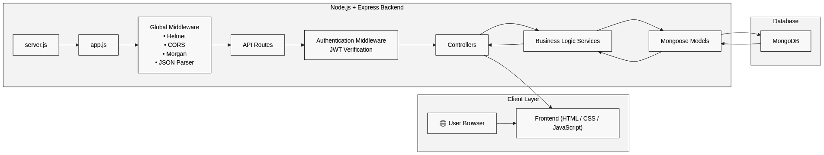
SYSTEM DESIGN
Architecture
Layered Architecture
Middleware Pipeline
EventSphere follows a strict Controller–Service–Data Access pattern, keeping each layer focused and testable.
Routes use composed middleware chains:
Controllers — Handle HTTP specifics only (req, res, status codes)
Services — Contain all business rules; controllers stay thin
Models — Manage schema definitions and Mongoose validation
[protect, restrictTo, validation, validate, controller]

Slide 4
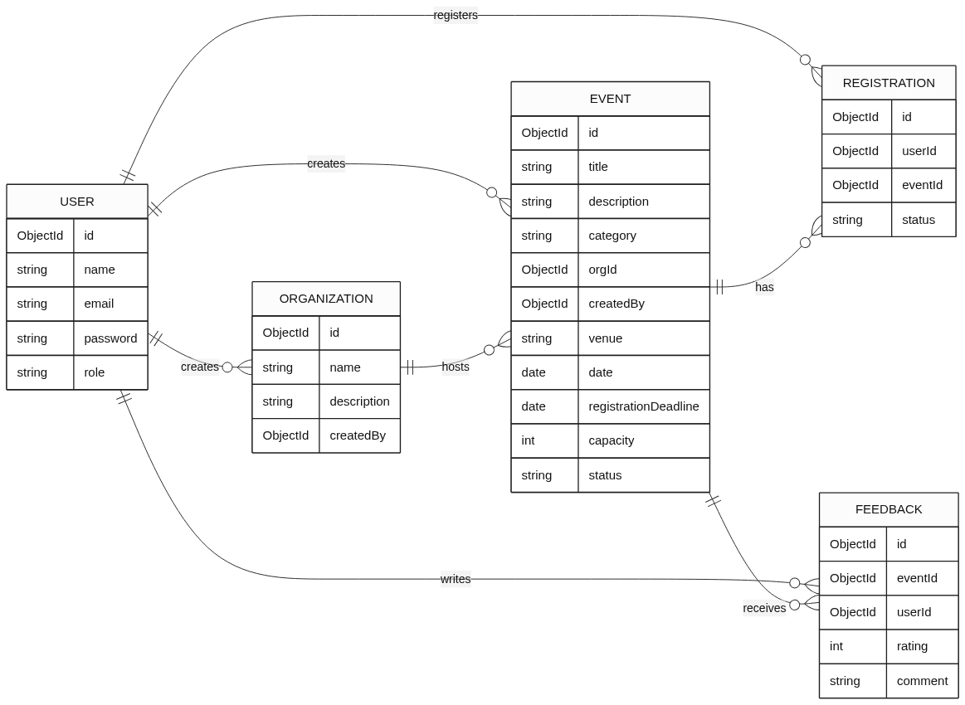
Database Design
Key Schema Highlights
User — Role field drives RBAC; password excluded from query results by default.
Event — Compound index on {status, date} for fast published-event queries.
Registration — Unique {userId, eventId} index prevents duplicate registrations.
Feedback — Unique {userId, eventId} index enforces one review per user per event.

Slide 5
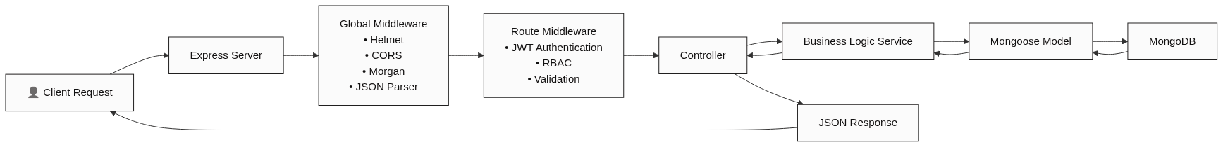
Request Lifecycle
Every request flows through a well-defined pipeline. Global middleware applies first, then route-level middleware handles authentication, authorisation, and validation. The Controller delegates business logic to the Service layer, which interacts with MongoDB via Mongoose. Errors at any stage are caught by catchAsync and handled centrally.

Slide 6





Authentication & Authorisation Flow
Signup
POST /api/auth/signup — Email checked, password hashed via Mongoose pre-save hook, tokens issued.
Login
POST /api/auth/login — Credentials verified via bcrypt.compare; Access + Refresh tokens returned.
Protect
protect middleware verifies JWT, decodes user ID, fetches user, attaches to req.user.
RBAC
restrictTo('organizer', 'admin') ensures only authorised roles can perform privileged actions.

Slide 7
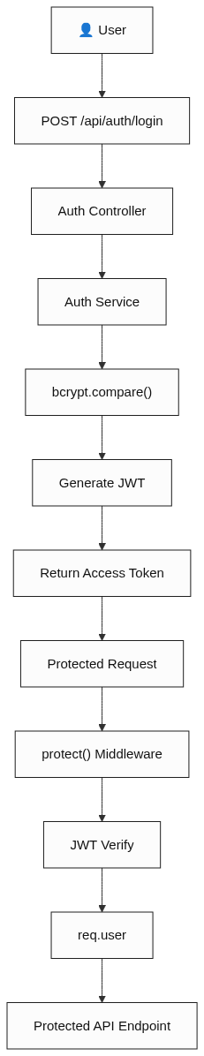
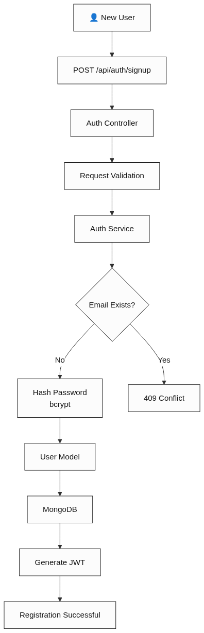
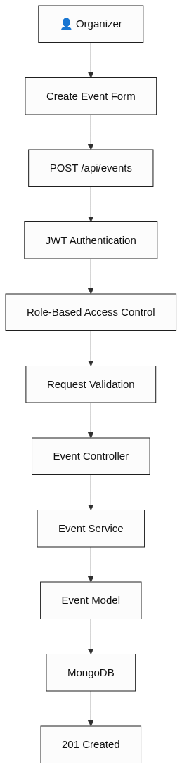
Authentication
Flow
User Registration (Account Creation) Flow
Event Creation Flow

Slide 8






Implemented Features
User Authentication
Role-Based Access Control
Login, signup, JWT generation, and bcrypt password hashing.
Distinct permissions for participants, organizers, and admins.
Event Management
Event Registration
Full CRUD for Events and Organizations with validation.
Register, waitlist, cancel, and mark attendance.
Feedback System
Centralized Error Handling
One rating and comment per user per event.
Unified operational error processing across the app.

Slide 9
API REFERENCE
API Documentation
Authentication
Events
Organizations
/api/auth
/api/events
/api/organizations
POST /signup — Register
POST /login — Authenticate
GET /me — Current user
GET / — List events (public)
GET /:id — Event details
POST / — Create (organizer)
PATCH /:id — Update
DELETE /:id — Delete
GET / — List all
GET /:id — Details
POST / — Create (admin)
Registrations
Feedback
/api/registrations
/api/feedback
POST /:eventId/register
PATCH /:eventId/cancel
GET /me — My registrations
GET /:eventId — All (organizer)
PATCH /:eventId/attendance/:userId
POST /:eventId — Submit (one per user)
GET /:eventId — View (public)

Slide 10
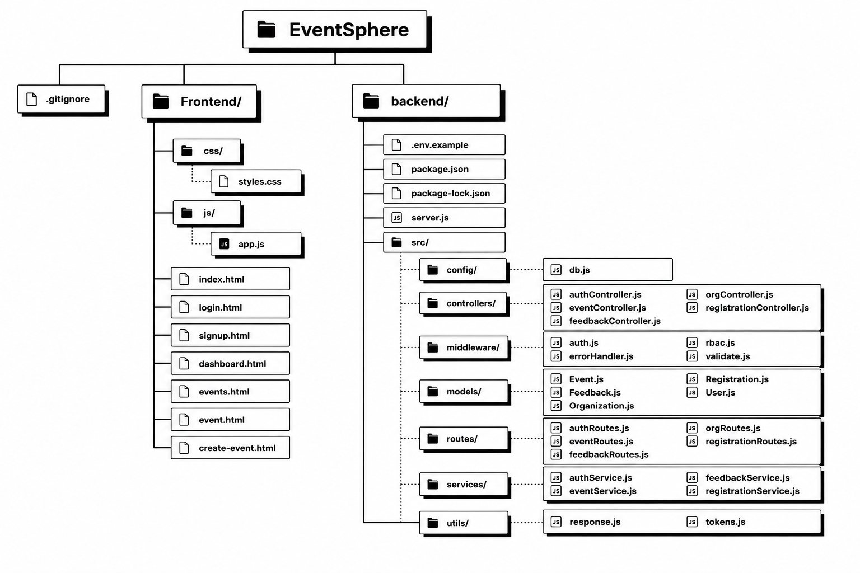
Repository Folder Structure
Backend — Core Logic
The backend/ folder follows a clean MVC-like separation. server.js bootstraps the app; src/ houses all source code split across controllers, services, routes, models, middleware, and utils.
Frontend — Static Assets
The frontend/ folder contains HTML pages and their associated css/ and js/ subdirectories, served statically by Express.

Slide 11
REFERENCE
Repository Inventory
Controllers & Routes
Models
auth — authController.js / authRoutes.js
events — eventController.js / eventRoutes.js
feedback — feedbackController.js / feedbackRoutes.js
orgs — orgController.js / orgRoutes.js
registrations — registrationController.js / registrationRoutes.js
Event.js · Feedback.js · Organization.js
Registration.js · User.js
Services
authService.js · eventService.js
feedbackService.js · registrationService.js
Middleware
Utilities & Config
auth.js — protect (JWT)
rbac.js — restrictTo (roles)
validate.js — validation wrapper
errorHandler.js — catchAsync, AppError, global handler
response.js — Standard JSON responses
tokens.js — JWT generation
db.js — MongoDB connection
server.js · app.js · .env.example · package.json

Slide 12
Security Measures
JWT Authentication
bcrypt Hashing
Helmet & CORS
Stateless tokens for secure, scalable session management.
Passwords never stored in plaintext in the database.
Secures HTTP headers and controls cross-origin access.
express-validator
DB Compound Indexes
Strict input validation at route level prevents injection attacks.
Unique indexes on userId + eventId prevent duplicate registrations and feedback.

Slide 13

Error Handling Strategy
AppError Class
catchAsync Wrapper
Global Error Middleware
This three-layer approach ensures every error — whether a validation failure, a database conflict, or an unexpected exception — is caught, classified, and returned as a consistent, human-readable HTTP response.

Slide 14
Future Improvements
1
Refresh Token Endpoint
Consume refresh tokens to issue new access tokens without re-authentication.
2
Security Hardening
Add express-rate-limit on auth routes and xss-clean for data sanitization.
3
Pagination & Filtering
Support limit, page, and sort query params on GET /api/events.
4
Automated Tests
Introduce Jest or Mocha/Chai — the repository currently has no test coverage.

Slide 15
Conclusion
EventSphere delivers a robust, secure, and scalable platform for seamless event management.
Full-Featured Platform
Secure & Reliable
Comprehensive API covering authentication, event lifecycle, and user interactions.
Robust authentication, role-based access, and input validation ensure data integrity.
Modular & Scalable
Unified Error Handling
Layered architecture designed for maintainability and future expansion.
Consistent error responses simplify integration and debugging for developers.
This foundation provides a powerful and extensible solution for your event ecosystem needs.

